Slide 1
7-1 Project Agile Presentation
Darienne Miller
CS 250 Software development lifecycle
Oct. 19th. 2025

Slide 2
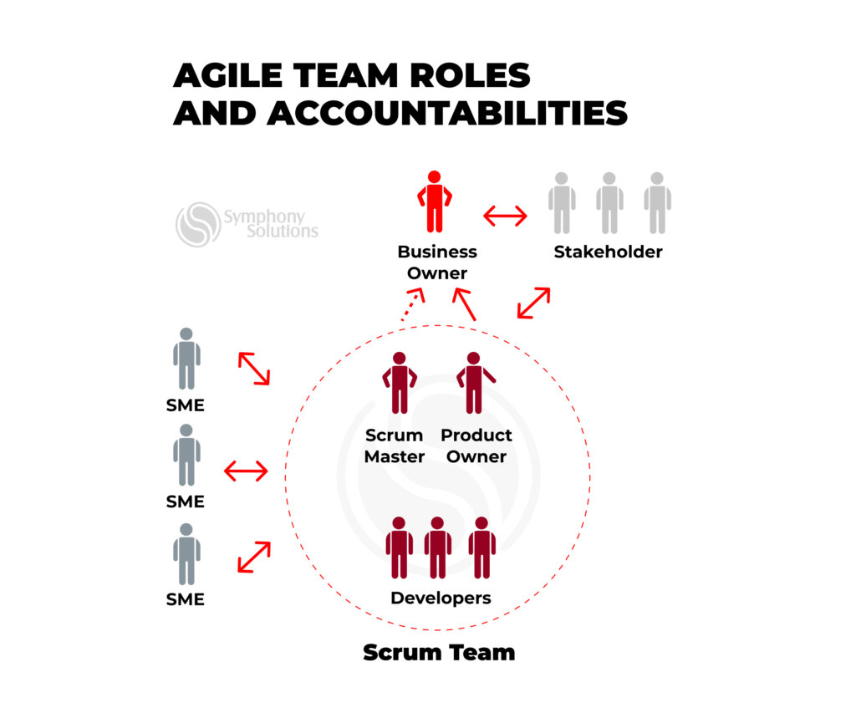
Agile Roles

Slide 3
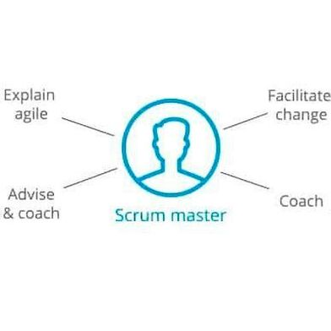
Scrum Master
The Scrum Master:
Serves as the facilitator and leader of the Scrum team
Oversees and prioritizes the product backlog
Coordinates Sprint planning and execution
Leads daily stand-ups, Sprint reviews, and retrospectives
Guides the team through each Sprint and Scrum ceremony
The Scrum Master acts as the cohesive force within the team, ensuring timelines are met, workflows stay organized, and Agile principles are consistently applied.

Slide 4
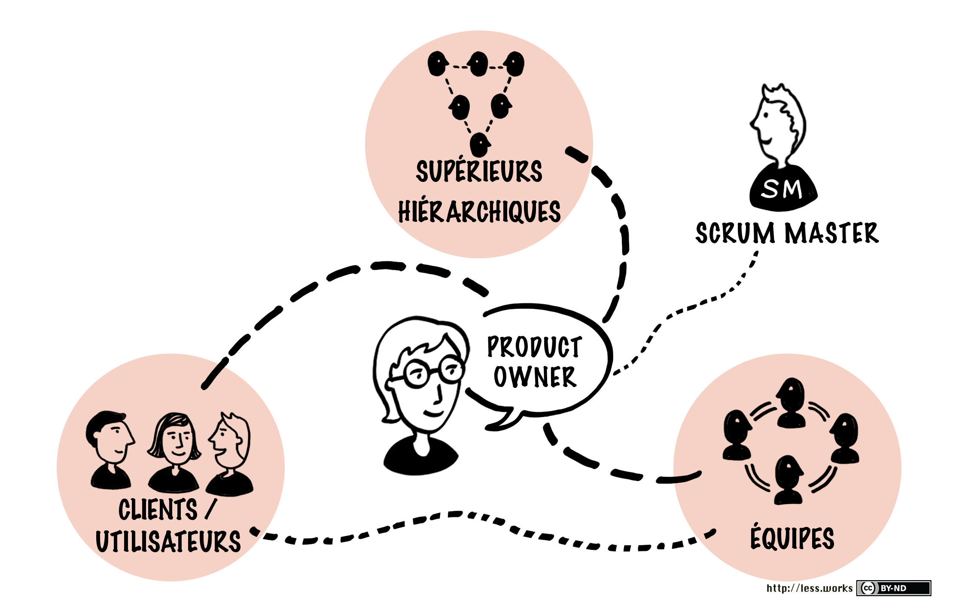
Product Owner
Product Owners:
Acts as the primary liaison between the Scrum team and external stakeholders
Gathers input from users and stakeholders to understand their needs
Translates collected insights into clear, actionable User Stories
Communicates these User Stories effectively to the Scrum team
Collaborates closely with the Scrum Master to support informed decision-making
Shares feedback from Sprint Reviews and Retrospectives with stakeholders
The Product Owner serves as the vital connection between the Scrum team and the outside world. Their role is to ensure that user requirements and stakeholder expectations are accurately captured and transformed into understandable, goal-oriented User Stories that guide the team's development efforts.

Slide 5

Developer
Developers:
Translate User Stories into functional features
Adhere to industry-standard coding practices
Maintain transparent communication about progress and challenges with the Scrum team
Collaborate closely with testers to ensure product functionality and reliability
Developers are the driving force behind the Scrum team's output. They ensure the product is secure, functional, and aligned with both user needs and stakeholder expectations. This is achieved through disciplined coding, continuous collaboration, and open communication throughout the development process.

Slide 6

Tester
Testers:
Design test cases based on User Stories and Sprint objectives
Execute tests to validate product functionality and performance
Document test procedures, outcomes, and any anomalies encountered
Communicate findings to Developers and the Scrum team
Identify and evaluate edge cases and uncommon user scenarios
Simulate user behavior to assess real-world usability
Testers serve as the quality assurance backbone of the Scrum team. Their role is to ensure the product performs reliably across all user interactions by rigorously testing both expected and unexpected behaviors. Through detailed documentation and continuous feedback, they help maintain a high standard of safety, functionality, and user satisfaction.

Slide 7
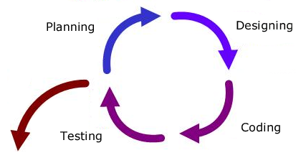
Phases of agile

Slide 8

The agile Software Development Lifecycle (SDLC)
Agile is a versatile approach that can be implemented in various ways
It serves as a flexible framework rather than a strict rulebook
Agile empowers teams to remain adaptable while maintaining steady progress
Success relies on thoughtful reassessment and intentional execution
Let’s dive into a practical example of how an Agile process can be structured...

Slide 9
Planning phase : project kickoff
Establishes the initial goals and requirements of the project
Collects foundational details such as budget estimates, timelines, and team roles
(e.g., Scrum responsibilities)
In subsequent iterations, this phase may be streamlined or integrated into the Design phase

Slide 10
Design phase : Laying the foundation
Establish the Minimum Viable Product (MVP) and outline key deliverables
Identify potential obstacles or constraints
Delegate tasks to team members and initiate development activities
This phase marks the launch point for each new iteration, setting the direction and structure for the work ahead.

Slide 11
Development Phase: Building the Solution
Developers implement the features defined in the project overview
Code is written following recognized industry best practices
Continuous communication with the team ensures transparency around progress and challenges
This phase focuses on translating plans into working software while maintaining collaboration and technical excellence.

Slide 12
Testing Phase: Ensuring Reliability and quality
The product undergoes thorough testing to validate performance
Verifies that all intended features function correctly
Identifies and investigates unexpected behaviors and edge cases
Testers approach the product from a user-centric perspective, thinking creatively to explore all possible interactions. They adapt standard test cases to suit the specific needs of the product and its users, ensuring comprehensive coverage and dependable results.

Slide 13
Deployment: Delivering the Product
The Agile team evaluates whether the product is ready for release
Decisions are guided by User Stories, similar to the Development phase
Successful deployment requires a clear understanding of target platforms and market needs
Deployment can be just as complex as development, demanding strategic planning and alignment with user expectations and technical environments.

Slide 14
Review Phase: Refining and Reflecting
Monitor product performance, deployment outcomes, and feedback from users, stakeholders, and the market
Evaluate the effectiveness of each iteration, identifying successes and delays
Gather and distill ideas for future iterations
The review process is essential for identifying and correcting flaws, while reinforcing strategies that proved effective. It ensures continuous improvement and alignment with project goals.

Slide 15
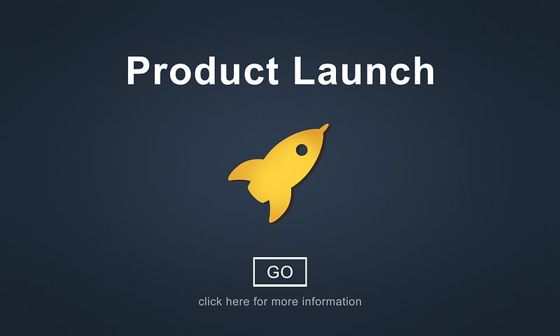
Product launch: A milestone Iteration
Releasing a product marks another iteration in the Agile cycle
The product should be stable and satisfy the majority of User Stories and Stakeholder requirements
Launching is a pivotal moment in the development lifecycle, often accompanied by heightened user expectations
Post-launch development can continue, using Agile principles to guide future enhancements and refinements

Slide 16
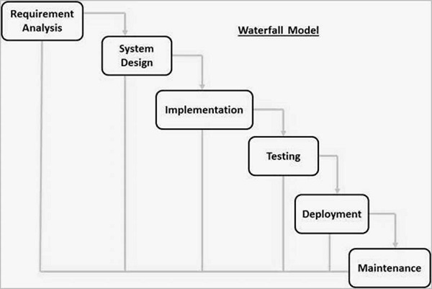
Waterfall Method

Slide 17
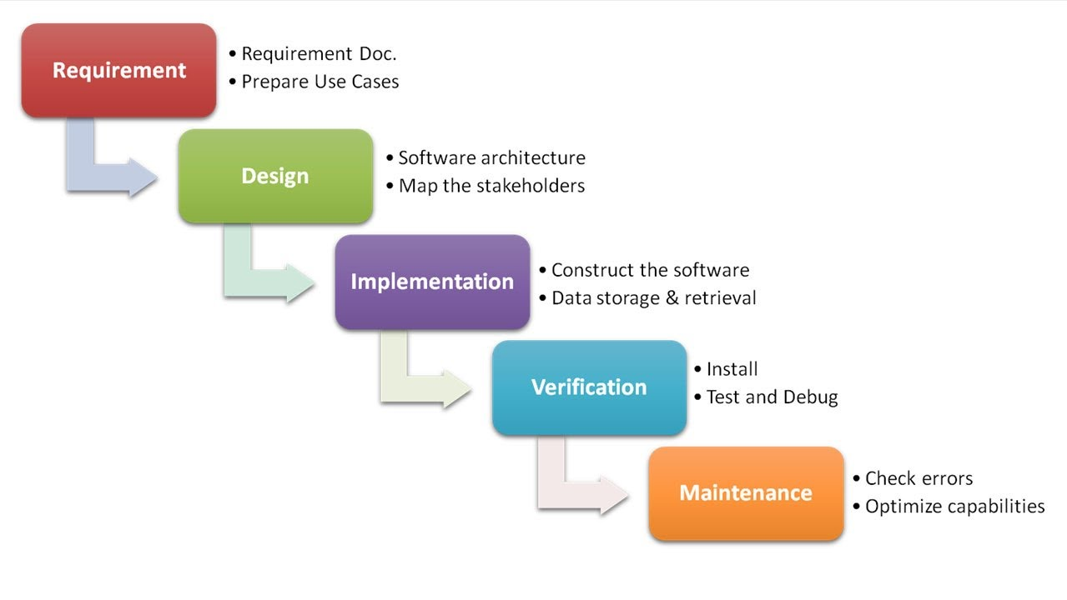
Traditional Waterfall Approach
Follows a linear, non-iterative structure
Requirements are gathered and finalized at the beginning of the project
The Development phase does not influence or alter the Design phase
Design is implemented without accommodating evolving needs or unforeseen challenges
Testing has limited impact on previously completed development work
Deployment marks the end of active development, followed only by maintenance
This model emphasizes sequential execution, which can limit flexibility and responsiveness to change.

Slide 18
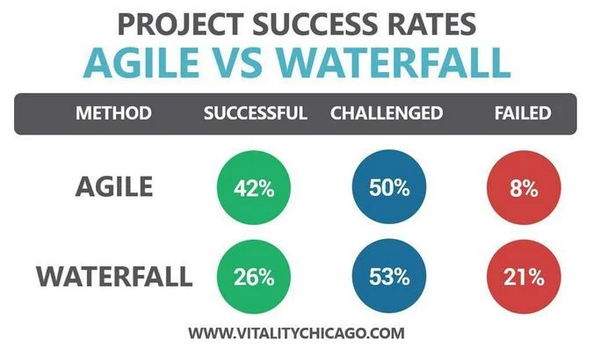
Agile Vs. Waterfall approach
Agile
waterfall
Iterative & incremental
Highly adaptable to changing the requirements
Continuous planning through the project
Frequent feedback from users and stakeholders
Ongoing testing during each iteration
Emphasizes cross-functional collaboration and daily communication
Large teams, evolving requirements, complex or innovation projects
Risks are identified and address early through iterations
Delivers working software frequently
Linear & sequential
Rigid; changes are difficult once the project starts
All planning is done upfront
Limited user involvement after the initial requirements are gathered
Testing occurs only after development is complete
Roles are more soiled and communication is less frequent
Small teams, well-defined requirements, predictable and stable projects
Risks may surface late in the process
Delivers the final product at the end

Slide 19
References
Cobb, C. G. (2015). SNHU. Retrieved from The Project Manager's Guide to Mastering Agile : Principles and Practices for an Adaptive Approach: https://research.ebsco.com/c/cyb354/ebook-viewer/pdf/tbfxle5mbr/section/lp_289?location=https%3A%2F%2Fresearch.ebsco.com%2Fc%2Fcyb354%2Fsearch%2Fdetails%2Ftbfxle5mbr%3Fdb%3Dnlebk
Cobb, C. G. (2015). SNHU. Retrieved from The Project Manager's Guide to Mastering Agile : Principles and Practices for an Adaptive Approach Chapter 9: https://research.ebsco.com/c/cyb354/ebook-viewer/pdf/tbfxle5mbr/section/lp_139?location=https://research.ebsco.com/c/cyb354/search/details/tbfxle5mbr?db=nlebk
Microsoft Ignite. (2025, September 29). Retrieved from What is Azure Boards?: https://learn.microsoft.com/en-us/azure/devops/boards/get-started/what-is-azure-boards?view=azure-devops&tabs=agile-process

